Slide 1
Shield Coin VM
A Secure Blockchain Platform for Smart Contract Execution

Slide 2
Introduction
The Shield Coin Virtual Machine (SCVM) serves as a specialized execution environment that enhances the Shield Coin blockchain, facilitating secure and efficient smart contract operations.

Slide 3
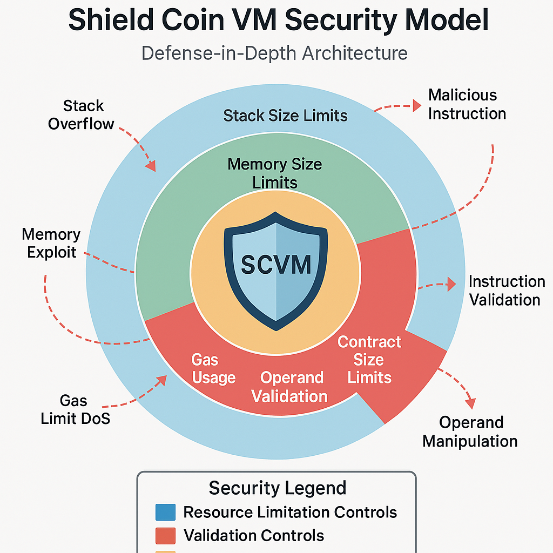
01
Key Features

Slide 4

Register-based VM Architecture
The Register-based architecture of the SCVM is specifically optimized for blockchain operations, allowing for faster execution of smart contracts by reducing the overhead associated with stack-based virtual machines. This design promotes efficient resource management and enhances the overall performance of contract execution.

Slide 5
Smart Contract Execution
The SCVM provides a secure environment for decentralized applications through its robust smart contract execution features. This environment ensures that contracts run as intended, protecting them from unauthorized access and potential vulnerabilities. Developers can deploy and interact with their contracts with confidence, knowing that the infrastructure is designed to mitigate common security risks.

Slide 6
Sandbox Execution
The SCVM employs a sandbox execution model, providing an isolated environment where smart contracts can be run safely. This isolation prevents malicious actions from affecting the host blockchain or other contracts. By containing execution within a controlled setting, the integrity and security of the overall system are markedly improved, ensuring that only verified operations are conducted.

Slide 7
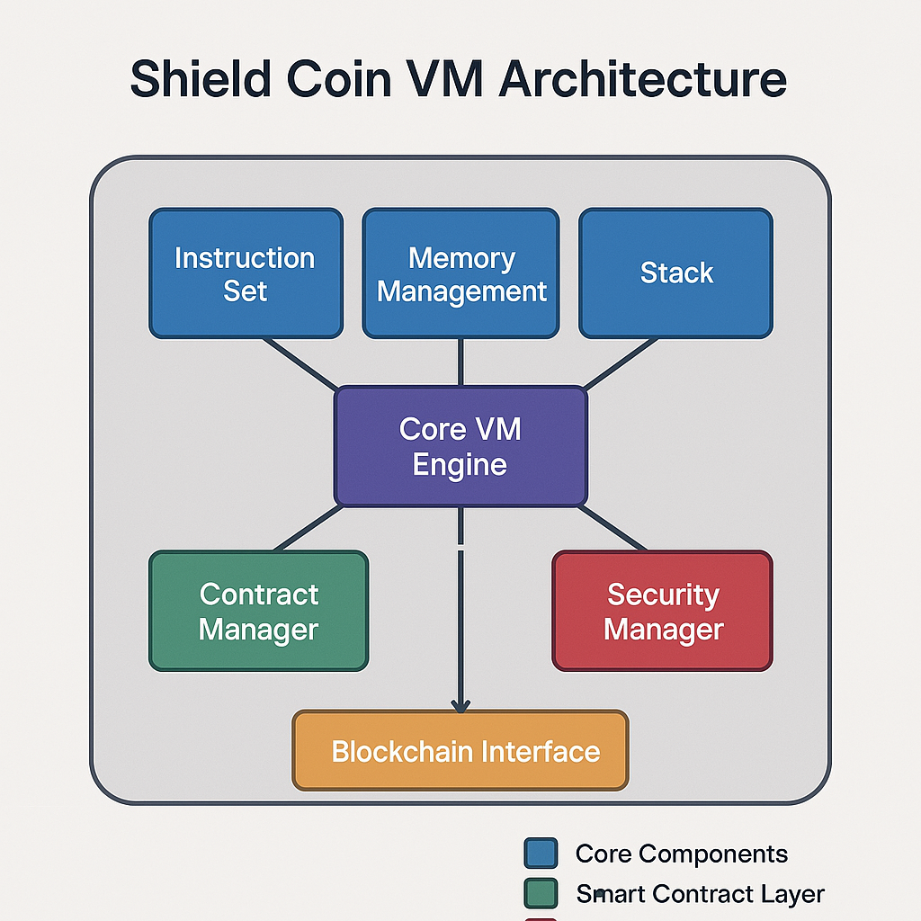
02
Technical Architecture

Slide 8
Instruction Set
The instruction set of the SCVM comprises a series of fundamental operations essential for executing smart contracts. This set includes a variety of operations, such as arithmetic functions, data manipulation, and control flow instructions, all of which are designed to be efficient for blockchain environments. The tailored nature of the instruction set helps optimize execution speed and resource utilization.

Slide 9
Memory Management
Efficient memory management is critical for the performance of the SCVM. The architecture incorporates an adaptive memory allocation system that dynamically manages storage requirements during smart contract execution. This ensures that memory usage is optimized, allowing contracts to efficiently access and manipulate data while preventing memory overflow and ensuring stability.

Slide 10
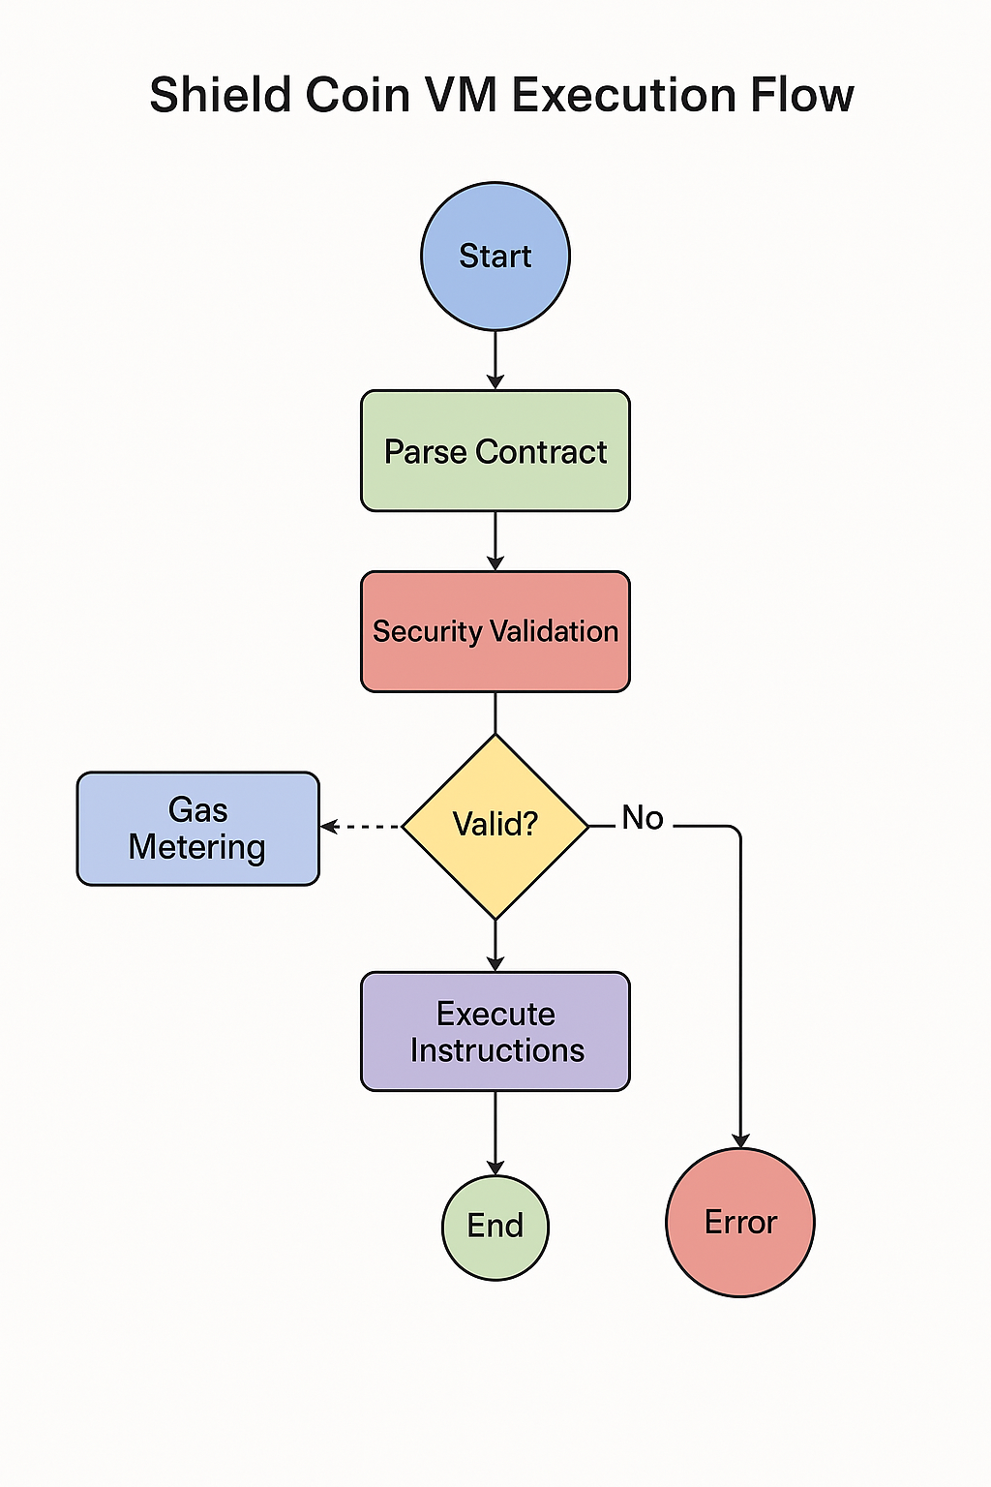
Stack
The execution stack in the SCVM plays a vital role in processing operations. It functions as a last-in-first-out (LIFO) data structure that holds temporary data for smart contracts during execution. By managing function calls, local variables, and intermediate results within the stack, the SCVM can efficiently execute complex operations and transitions, maintaining the necessary state information throughout contract execution.

Slide 11
Conclusions
The Shield Coin Virtual Machine (SCVM) offers a robust framework for secure smart contract execution, backed by an optimized architecture and essential features such as sandbox execution and efficient memory management. With its specialized instruction set and stack operations, the SCVM is positioned to support innovative blockchain solutions while ensuring operational integrity and security.

Slide 12
Thank you!
Do you have any questions?
+91 620 421 838

